Slide 1

A/B Testing in VR
Better Sales and Happier Customers

Slide 2
Who are we?
Tengio build apps and websites with clients like Gumtree, Groupon, Depop, Monzo
Working on VR over the last year

Slide 3
VR for Architecture
extensive experience in consumer facing applications, interfaces and experiences
use this knowledge in creating high quality VR experiences of architect’s models

Slide 4
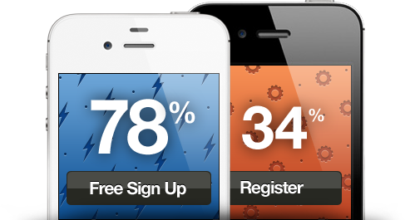
A/B Testing
One or Several variations of an interface or experience
Have users test the implementation and determine the best solution through analytics
Repeat

Slide 5
VR A/B Testing
Multiple Models
Carefully selected target groups
Analytics
Realistic experience

Slide 6
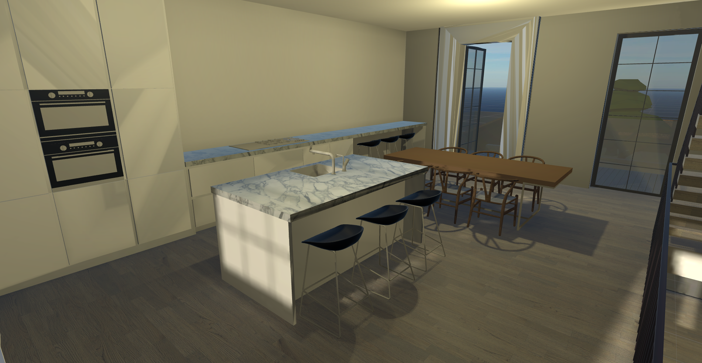

Slide 7
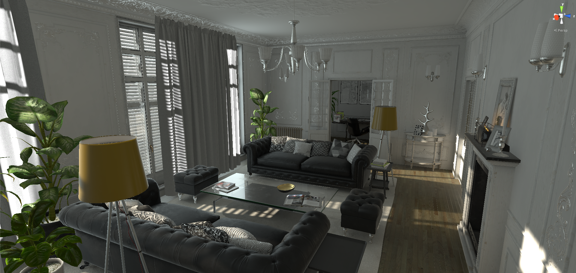

Slide 8
Target Markets
Architects
Retail, product placement, Advertising/PR, Marketing firms
Retail, shop floor design
Shopping Malls, Airports

Slide 9
Questions?
akshay@tengio.com
q@tengio.com
www.tengio.com

